Slide 1

Artificial Neural Network Structure
Professor Bo Liu
James Watt School of Engineering

Slide 2
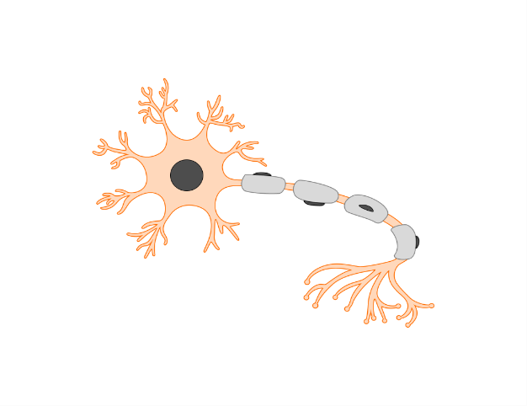
Major components and structure
Artificial neural networks:
Input layer.
Hidden layers.
Output layer.
Connections.
Input layer
Hidden layer
Output layer
A node is activated for calculation and then pass the results to the next node
Input 1
Output
A neuron is activated and pass the bioelectric signal to the next neuron
Input 2

Slide 3
Major components and structure
Artificial neural networks (sometime called neural networks, or neural nets)
Input layer.
Hidden layers.
Output layer.
Connections.
Signal is processed and passed between neurons
Input layer
Hidden layer
Output layer
Input 1
Output
Input 2

Slide 4
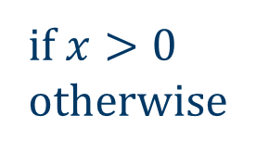
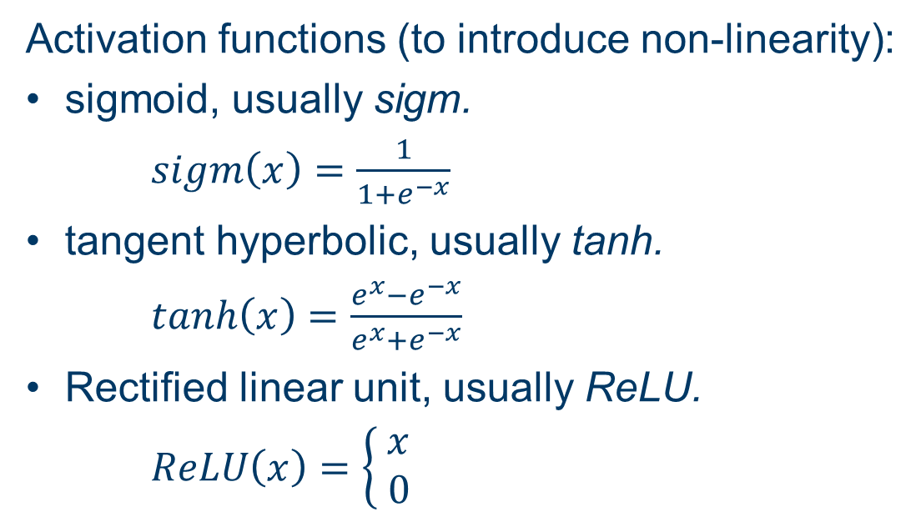
Processes and activation within a neuron
Activation functions (to introduce non-linearity):
sigmoid, usually sigm.
$sigm\left(x\right)=\frac{1}{1+e^{−x}}$
tangent hyperbolic, usually tanh.
$tanh\left(x\right)=\frac{e^{x}−e^{−x}}{e^{x}+e^{−x}}⁡$
Rectified linear unit, usually ReLU.
$ReLU\left(x\right)=\left\{\begin{aligned} x \\ 0\end{aligned}\right.$
Related functions:
sigm_mooc
tanh_mooc
relu_mooc
if $x>0$
otherwise

Slide 5



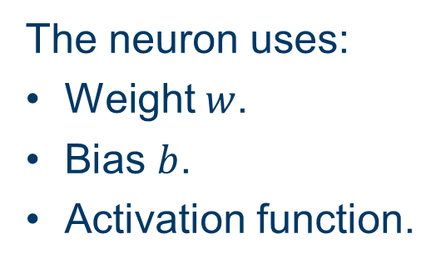



Processes and activation within a neuron
$${\text{Input} \text{to} \text{the} \text{neuron}i}_{1}=0.8$$
The neuron uses:
Weight $w$.
Bias $b$.
Activation function.
Weight $w_{1}=0.25$
Bias $b_{1}=0.12$
Output from the last neuron as input to next neuron
$i_{2}=0.579$
$$w_{1}i_{1}+b_{1}=0.25×0.8+0.12=0.32$$
The calculations include:
Multiplication.
Addition.
Activation.
Activated output: $sigm\left(0.32\right)=\frac{1}{1+e^{−0.32}}=0.579$
Weight $w_{2}=0.14$
Bias $b_{2}=−0.3$
$$w_{2}i_{2}+b_{2}=0.14×0.579−0.3=−0.2189$$
Activated output: $sigm\left(−0.2189\right)=\frac{1}{1+e^{−0.2189}}=0.4455$

Slide 6




Thanks!
#UofGWorldChangers
@UofGlasgow

